Slide 1
Speech Evaluator - 101
(A Quick Guide For Some Tips!)
Cynthia Sech - Facilitator

Slide 2
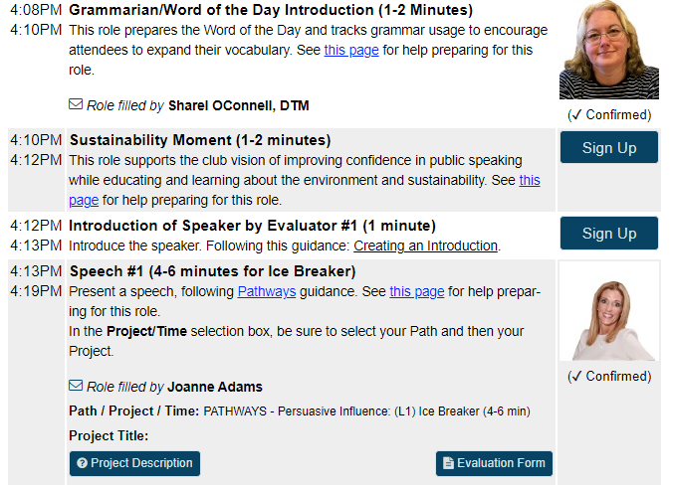
Speech Evaluator - Preparation
Log in to Capgemini Toastmasters:
  Toastmasters - Capgemini
Select Meeting Agenda, and filter to the appropriate week to volunteer as Speech Evaluator
Locate “Introduction of Speaker by Evaluator #1 or #2” – Sign Up
  Identify your Speaker’s Path/Project Time
  Download the Project Description and Evaluation Form
    Project Description and Evaluation Form will be tied to the Speaker’s Path/Project

Slide 3
Speech Evaluator - Preparation
Schedule a brief call with your Speaker, prior to our Wednesday call
  Confirm their Path/Project/Time
  Ask the Speaker what they would like to be evaluated on.
  Prepare a brief 1–2-minute introduction of your Speaker. This can include their Capgemini history, their Toastmasters Path and anything else they’d like to share.
    Your final sentence of your introduction will be: Speech Presenter’s Name, Speech Title, Speech Title, Speech Presenter’s Name.
      For example: I’m pleased to introduce Mary Smith, My Career Challenges, My Career Challenges by Mary Smith.

Slide 4
Speech Evaluator - Evaluation
Review the Speech Evaluation Form, as each is specific to the Speaker and their topic.
Be honest, positive, and supportive while also offering constructive feedback and actionable suggestions for improvement.
  Share examples and explain why and how something could be improved by providing examples.
Focus on the speech and not the Speaker. Evaluate what the Speaker says and does.
Be unique. Avoid stating the obvious and identify what will strengthen the Speaker
Use helpful words: Instead of saying "you should have," use phrases like "I believe," "My reaction was," or "I suggest".

Slide 5
Speech Evaluator - Evaluation
Report what the speech makes you
SEE
Report what you
HEAR
during the speech
Report how the speech makes you
FEEL
SEE
HEAR
FEEL

Slide 6
Speech Evaluator – Evaluation Form
It’s helpful to go back and review the speech from the recording to again focus on the areas for which you are evaluating.
Write down your feedback and suggestions on the Evaluation Form.
Email the Evaluation Form and consider offering a time to debrief with the Speaker in case they would like to review.

