Slide 1


How to be the Timer??
17th June 2024
Notes:
Good afternoon, everyone,
Thank you for joining today’s session on ‘How to be a Timer?’
Before we begin a couple of housekeeping items. Please
- be on ‘mute’ at all times during the session
- be on camera as a that is a pre-requisite for a Timer Role; so let’s start practicing right away
- post your questions in the chat or you can come off mute to ask those during the Q&A session
Sharel will keep me on track by playing the Timer for today’s meeting. At 10 mins, her background will turn green, amber/yellow at 15mins and red at 20mins.
Let’s dive right in!

Slide 2
Agenda!
How to download the Timer backgrounds and add them to your Teams?
How to use the different color backgrounds to indicate the timing in the meetings?
How to report out on how everyone did with their timing?
Topic 1
Topic 2
Topic 3
Notes:
The agenda of today’s meeting is primarily to focus on three main topics (not necessarily in this order)
1. Downloading Timer backgrounds, adding these to your Teams
2. Using the backgrounds during a meeting
3. Reporting how everyone did on time
But before we jump into these, I would like to do a little poll. So let us begin…..

Slide 3

Let us begin….
POLL
Notes:
All of you must participate… ☺
Great job everyone! Thank you!!
Now let’s talk about who a timer is??

Slide 4






Who is a Timer?
Timer is the one who keeps the entire meeting running on time, indicating how we are doing during each segment, without interrupting the speakers.
Uses a Stopwatch throughout the meeting
Monitors the meeting
Notes the time of each segment i.e. role
Indicates the time of each segment i.e. role using the Team background
Presents a report on the timings of each segment
i.e. role at the end of the Meeting
Notes:
As the timer, you play a fundamental role in keeping club meetings and members’ speeches on track.
The timer is a simple but essential meeting role.
A stopwatch is a Timer’s best friend, as they closely monitor the meeting progression, frantically noting everyone’s time, use the color backgrounds to indicate time elapsed, and finally present a report on every segment’s time noting who is over, under or on time.
“Whose timings should we monitor?”, you ask. Well!! Everyone’s time. Right from the Toastmaster to the role introductions, speaker introductions, planned and impromptu speeches which is the Table Topics, evaluations, reports.
A good timer notes and reports everyone.
Here’s the agenda for our upcoming meeting.
https://28677110.toastmastersclubs.org/agenda-02119564.html
All the segments & roles that you see have to be timed and monitored. Next to each segment/role, you’ll see the time that is allocated for it. That is your cue to measure everyone.

Slide 5
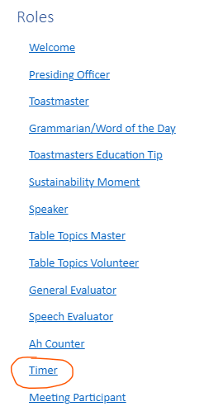
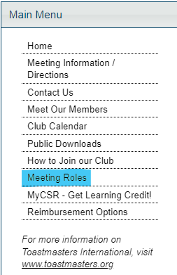


Learning Resources
On the Toastmasters International site, there is a handy resource called “A Toastmaster Wears Many Hats”
https://toastmasterscdn.azureedge.net/medias/files/pathways/toastmaster-wears-many-hats/1167d-a-toastmaster-wears-many-hats.pdf
In FreeToastHost (https://28677110.toastmastersclubs.org/)
Notes:
In our FTH site, under the main menu, there is a section on Meeting roles. It contains information on every role that is in a Toastmasters club.
There is another exhaustive resource on the TMI website, called “A Toastmaster Wears Many Hats” which again elaborates every role there is in a Toastmasters club.
Next let’s see where to get the Timer and general meeting backgrounds.

Slide 6
Timer Backgrounds
Timer backgrounds are available on the Toastmasters International site:
https://www.toastmasters.org/resources/timer-zoom-backgrounds
General meeting backgrounds are available on the Toastmasters International site:
https://www.toastmasters.org/Resources/Zoom%20Virtual%20Background
Notes:
On the TMI website, the timer backgrounds are available for download in various languages. I have put the link in the chat.
The one at the very bottom “Download Graphic file” is the English version.
Save them to your device and unzip the folder.
Let’s do it!!
Give me a thumbs up if you’ve finished downloading the backgrounds.
Simple!!
You have the General Meeting Background available for download on the TMI website. Link is in the chat.
Download and save it!
Next is adding these backgrounds to your Teams.
Now that we are all on this meeting, let’s do it together.
Click on the 3 little dots with ‘More’, you see the video effects and settings option, click on that.
Next, you’ll see backgrounds, in the top row you see the grey tile with ‘Add new’, it opens the dialog box to select files to add.
Navigate to the folder where you saved your backgrounds and add the first one, repeat the process for the other two.
Add the general meeting background just like we added the Timer background.
Give me a thumbs up if you’ve finished adding the backgrounds.
All right let’s see everyone’s backgrounds..
How to switch between background?
You would keep the video setting window open at all times and click on the background (a check mark will appear) and then click on apply when you have to change the color. (demo it quickly)
You now know what you need to do, you have your backgrounds.. when toastmaster calls upon you, you are ready!

Slide 7
Timer Role Script
This is an example.
Good evening / afternoon Mister / Madam Toastmaster, fellow Toastmasters, and guests. As Timer, I will time the Table Topics speakers, formal speeches, and the evaluations. I will also alert each speaker of the time they have left, using the green, yellow/ amber, and red cards, which denote specific times remaining.
Table Topics Speakers should limit their remarks to no more than 2 minutes.
At 1 minute, I will raise the green card.
At 1 minute and 30 seconds, I will raise the yellow card.
At 2 minutes, I will raise the red card.
Those giving speeches should limit their remarks to their specific speech times,
Ice Breaker speeches should be 4-6 minutes in length.
At 4 minutes, I will raise the green card.
At 5 minutes, I will raise the yellow card.
At 6 minutes, I will raise the red card.
Most other speeches should be 5-7 minutes in length.
At 5 minutes, I will raise the green card.
At 6 minutes, I will raise the yellow card.
At 7 minutes, I will raise the red card.
The individual evaluations should be between 2-3 minutes.
At 2 minutes, I will raise the green card.
At 2 minutes and 30 seconds, I will raise the yellow card.
At 3 minutes, I will raise the red card.
Thank you Mister / Madam Toastmaster
Notes:
At the very beginning when the Toastmaster is introducing all the roles, the Timer also introduces their role.
Here’s an example from TMI, which you can reword as you need.
It should include what is the role with an example of how you are going to perform the timer role, mention what you will report at the end of the meeting.
Remind that you should be pinned to the screen at all times.
***Talk about various times ranges – these are cues for switching backgrounds.****

Slide 8
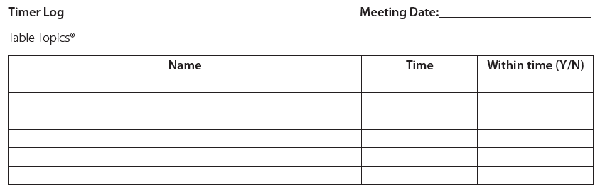
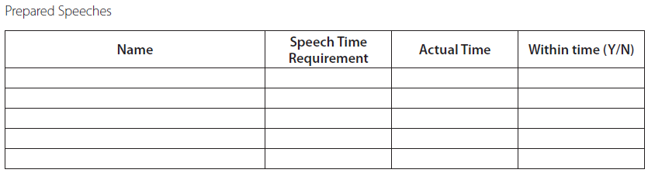
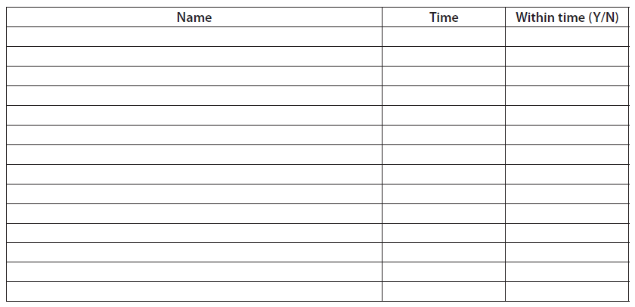
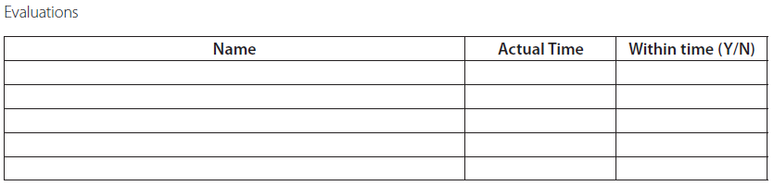
Making a note of everyone’s time
Notes:
How will you evaluate?
Format helps to tabulate systematically

Slide 9
Let us test our understanding….
POLL

Slide 10
Q&A

Slide 11
Thank you

