Slide 1
General Evaluator
The General Evaluator leads the Evaluation portion of the meeting and evaluates the entire meeting.
(Facilitator Laverne Brown)
Notes:
Tips/TIdbits: WOTD

Slide 2
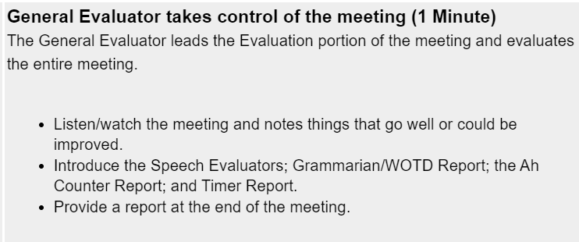
General Evaluator Role
Explain the purpose and benefits of evaluations to the group.
The GE takes over from the Toastmaster as the "emcee" of the meeting.
Welcomes each of the speech evaluators to present their reports.
Welcomes the Grammarian, Ah Counter, and Timer and asks for their reports.
Gives their evaluation of the entire meeting.
Hands the meeting back to the Toastmaster to finish the meeting.

Slide 3
General Evaluator: Tips
BEFORE the MEETING
Have a copy of the agenda in front of you at all times.
2) Observe how guest are welcomed and any other attributes that creates an experience
DURING the MEETING
1) Pay close attention to each segment of the meeting and take notes.
2) Did the meeting start on time?
3) Was the Grammarian, Ah Counter & Timer prepared?
4) Did the meeting stay w/in the allotted timeframe?
AFTER the MEETING
If there is time ask the timer to give you 1-2 mins to write your evaluation, if we are running behind use the notes you took during the meeting.
In your evaluation offer 3 strengths, 2 area of improvement and 1 WOW!
Notes:
Before the Meeting:
I usually have a copy of the agenda next to me - I usually print it because I need to take notes.
I also have my own speaking points labeled with who is doing what
During the Meeting:
take notes of things other evaluators might not mention (remember this is the overall meeting)

Slide 4

General Evaluator - Tidbits
Partner with the Sergeant At Arms to make sure the following roles are filled, and each Toastmaster is in the meeting: Grammarian, Ah Counter & Timer
Pay attention to the timing of each section of the meeting and help each Toastmaster along if we are running short on time.
Provide an accurate assessment and meaningful suggestions on club proceedings such as timeliness, enthusiasm, preparation, organization, and performance of duties.
Try to include the Word Of The Day in your report as often as you can.
"The goal is not to be perfect by the end. The goal is to be better tomorrow."
—Simon Sinek

